Slide 1



AI PERSONAS
Enrico Chen - s337750
Van Thanh Nguyen - s336748
Xiaoning Ma - s337332

Slide 2



Table of Contents
Challenges
Objective
Research Questions
Introduction
Method
Experiments
Methodology
Conclusion
Manage
Appendix
Conclusion

Slide 3


Challenges
In the context of delivering new products or enhancing existing ones, main pains are:
Consumers Insight Department -> high time demand for data collection and analysis
Product Department -> product development and product testing difficulties
Marketing Department -> high cost and uncertain advertisement campaigns
IT Department -> limited data, model testing

Slide 4

Objective - Project Value Proposition
For business units struggling in evaluating marketing performances, customer understanding, models and ideas testing, our software allows interacting with data-driven AI Personas representing the different market segments

Slide 5

Objective - Sustainable Development Goals
Our project is aligned with the SDG 9 - Industry, Innovation and Infrastructure. By using advanced AI improve company’s efficiency and effectiveness.

Slide 6
Objective - Project Goal
The goal is to develop a software application where employees can interact dynamically with AI Personas representing different market segments to:
Identify weak ideas at an earlier phase by saving time and resources
Enable focused market strategies
Scale winning concepts efficiently and effectively

Slide 7
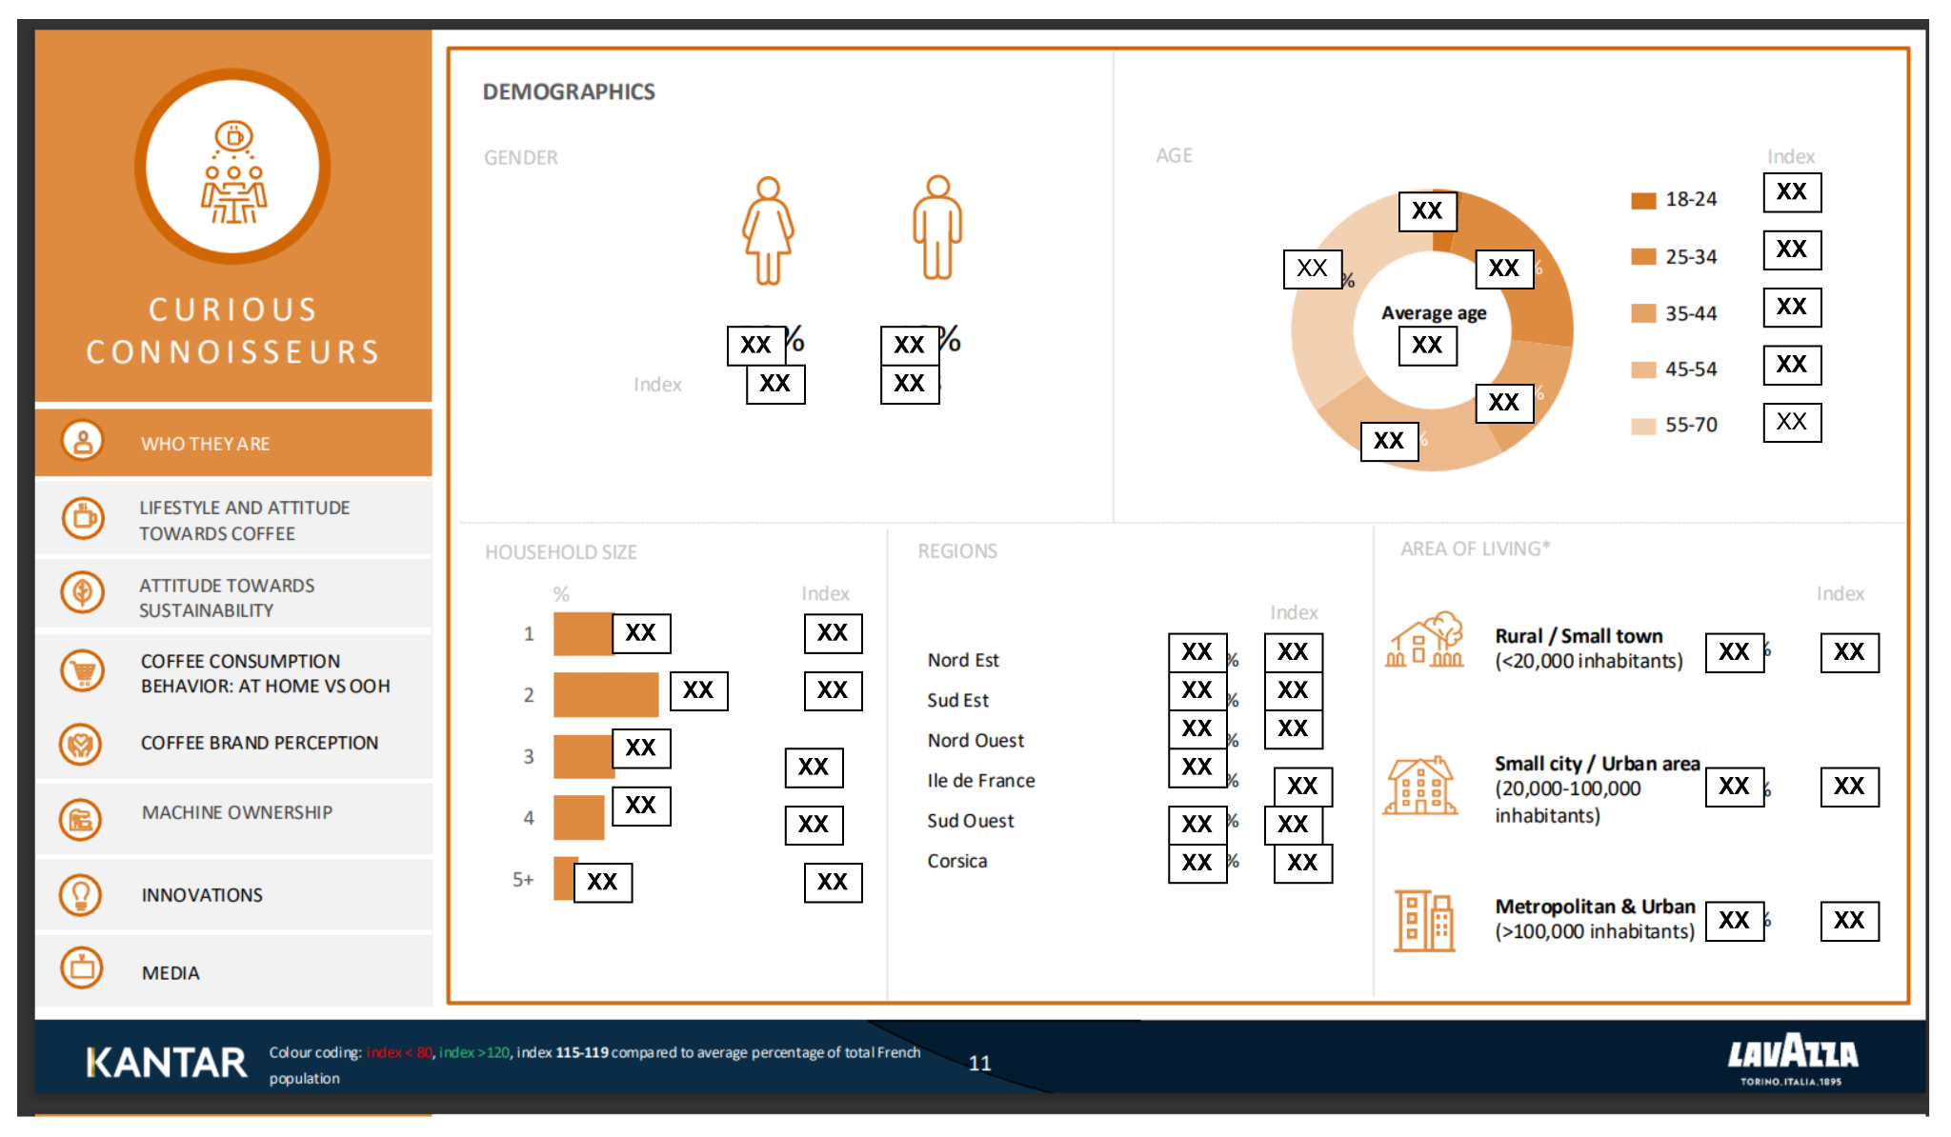
Research Questions
Q1 (Extraction): How can we extract structured data from complex, visually rich PDF in an accurate and automated way?
Q2 (Personality): Can "Reasoning Traits" (Style Profile, Value Frame) be derived from the raw data to create AI Personas?
Q3 (Grounding): How to prevent models from hallucinations?
Example data
Notes:
During conducting the project, we meet some very important questions: - Q1: extract data from visually rich pdf
- here is an exemple page of the raw data, it typically has multiple not only the charts but also may meaning full symbol, and layout
-Q2: how can we extract the persona traits from this raw data
- Q3: how can we prevent model from hallucications from provided data

Slide 8
Method - System Architecture
UI
FE
Application Layer
Persona Configuration
Ingestion service
Q&A service
Report service
Auth
Communication Layer
RPC server
Cache
Event Broker/ Message Queue
Core Layer
Monitoring and Evaluation
Orchestrator
Prompt Construction
AI Persona Router
Evaluation
Metric & Alerting
Input Handler
RAG
Persona registry
Data Storage
Business logic DB
Object storage(S3)
MCP Server
Memory
Explanation
Vector DB
Search engine
(*) More details in the Appendix
Notes:
Design a system with multiple different components and layers
UI - allow user interact with the system through front end
Application layer allow handling the business logic of the application
Communication layer allow components of the system interact each other efficiently
Core layer is the brain of the system allow the system have ability to thinking and reasoning, handle the agent interaction to align it with main objectives such as stick with a persona and avoid hallucination.
Monitoring and Evaluation layer allow to monitor and evaluate the performance of entire system
Data storage allow to persist different type of data
The highlighted components with blue corlor here are the main components we are going to focus in scope of this course

Slide 9

Method - Functional Diagram
2.1
2.
Memory
Text
2.2
PDF
1.Query image/pdf
3.
Input Handler
2.3.
Orchestrator
Image
1.1.
4.
RAG
4.1
5.
4.2
Websearch
MCP server
Data Services
4.3
6.
Explanation
APIs
7.
4.4
Other tools
Prompt construction
8.
Persona registry
9.
10.Output
AI Persona Router
Fine-tuned Persona model
(*) More details in the Appendix
Notes:
We will see how the components of the system interact eachother to handle the query of user in this functional diagram
User sent input possibly has images and pdf -> orchestrator are an agentic planner of the system : applied some design pattern such as CoT and ReAct to plainning the strategy to answer the query, decide which actions should be done: -> call the memory to retrieve the relevant history of the chat -> parsing extracting useful information from input -> call the RAG to retrieve relevant internal fact data -> call Model Context Protocol server to using some useful tools such as websearch, call external apis … -> contexts will be aggregated by orchestrator-> entire the reasoning process will be tracked by explanation services to allow explain the reasoning and the source of used data.
All relevant context will be sent to prompt construction and be enhanced by persona traits -> stick llm model with particular persona during the generation answer and avoid hallucination

Slide 10
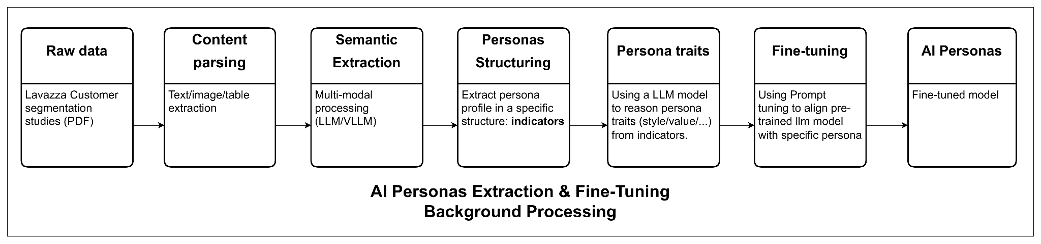
Method - Functional Diagram
Notes:
n the persona extractions pipeline, i will present like the follow of the diagram basically, from raw data -> parsing to get data of eachpage -> using vllm model to extract useful data from page -> transform it into more structure data called indicators, indicators are stagements and mectrics which related to persona of customer segmentation -> aggreage indicators of each persona and sent to llm model to resasoning generate the structure data discribe for the persona such as style, value, behavior, priorities, ... -> apply this structure data for prompt tuning to align pretrain model with a specific persona we assume that generation llm model trained on massive data which contains multiple different personas. prompt engineering applied here helps to activate the specific persona we want the model to stick with

Slide 11
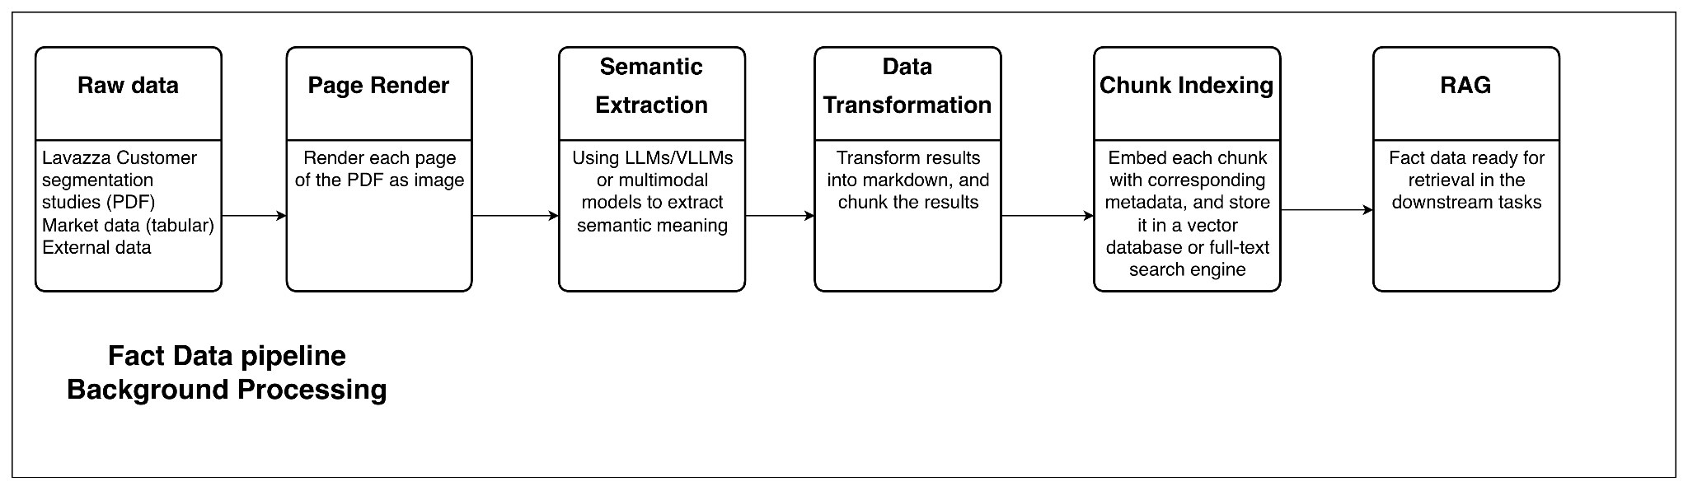
Method - Functional Diagram

Slide 12


Experiment - LLM Generation Demo
Front End
Back End
In general, what is your age?
Load Persona JSON
Embed snippets
Index embeddings
As Curious Connoisseurs, we tend to skew toward older groups, with a significant portion of our demographic falling between 35 and 70 years old. Specifically, 35% are between 35-44 years, 15% are between 45-54 years, and 24% are between 55-70 years. Our average age is 47 years, reflecting a mature and experienced cohort. This age distribution aligns with our exploratory nature and appreciation for high-quality, innovative products.
Retrieve relevant snippets
Build system prompt
Generate persona-style answer

Slide 13



Experiment - Data Description
Source & Scale
Data Structure
Key Dimensions
Kantar France 2023
4,001 Respondents
9 consumer segments
Rich qualitative + quantitative data
Multi-modal composition
Inconsistent layouts across segments
Mixed granularity
No unified or machine-readable format
Demographics
Psychographics
Coffee attitudes
Consumption behaviours
Brand perception & sustainability attitudes

Slide 14


Experiment - Experiment Configuration
Model
MPNet: Converts persona indicators into vector embeddings
Mistral: Produces the final persona-styled answer
Temperature = 0.5 Balanced creativity and consistency
Top-p = 0.5 Limits randomness; promotes focused outputs
Max tokens = 4024 Allows long persona-consistent explanations
Timeout = 300s Ensures long retrieval/generation runs complete
Parameters

Slide 15
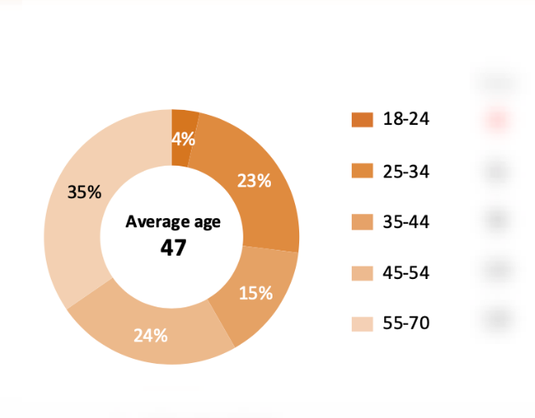
Experiment - Quality Assessment
In general, what is your age?
As Curious Connoisseurs, we tend to skew toward older groups, with a significant portion of our demographic falling between 35 and 70 years old. Specifically, 35% are between 35-44 years, 15% are between 45-54 years, and 24% are between 55-70 years. Our average age is 47 years, reflecting a mature and experienced cohort. This age distribution aligns with our exploratory nature and appreciation for high-quality, innovative products.

Slide 16

Conclusions
Objective
To create data-driven AI personas that support accurate consumer insight and decision-making.
Method We combined multi-modal data extraction, persona trait generation, and a RAG-enhanced LLM pipeline within an orchestrated system architecture.
Why Effective This approach ensures factual grounding, consistent persona behavior, and reliable, insight-aligned responses.

Slide 17



Manage
Enrico
Semantic extraction of fact data
Fact data indexing
Retrieval logic in RAG system
Corresponding slides
Thanh
System architecture design
Persona semantic data extraction
AI persona prompt tuning
Corresponding slides
Xiaoning
AI persona common trait extraction
AI persona inference and serving
Quality assessment
Corresponding slides

Slide 18

Enrico Chen - s337750
Van Thanh Nguyen - s336748
Xiaoning Ma - s337332

Slide 19

Appendix

Slide 20
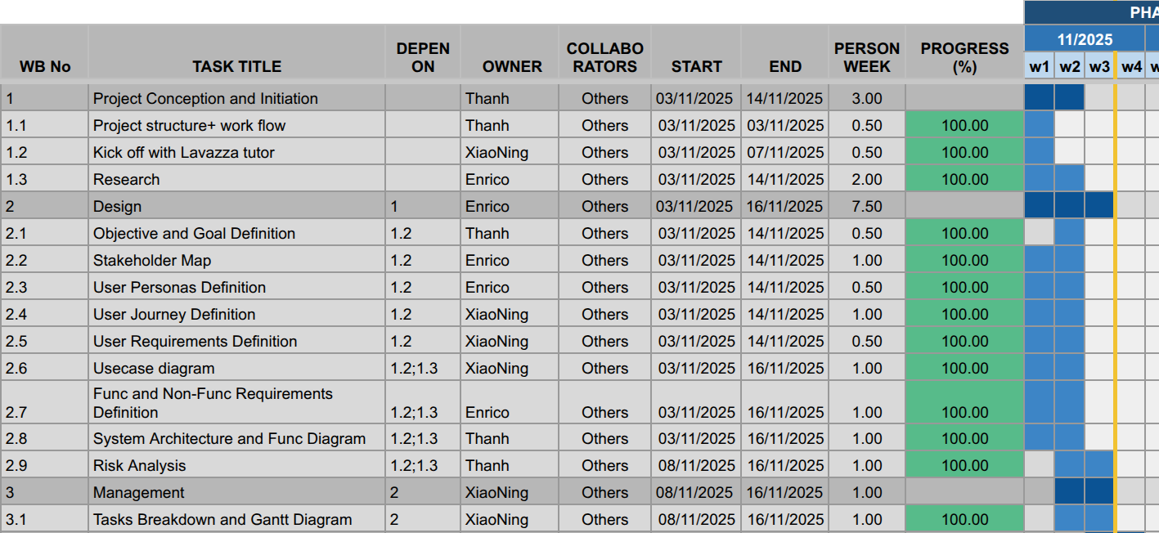
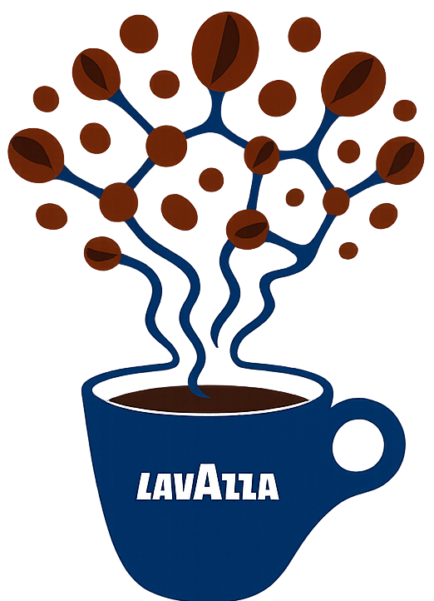
Manage - Gantt

Slide 21
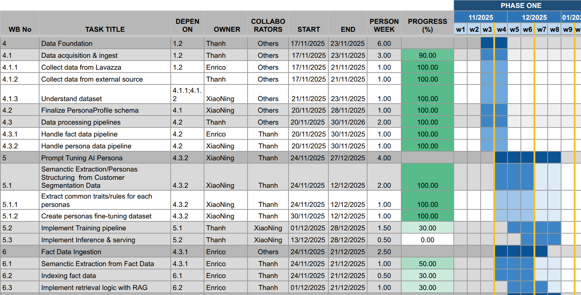
Manage - Gantt

Slide 22
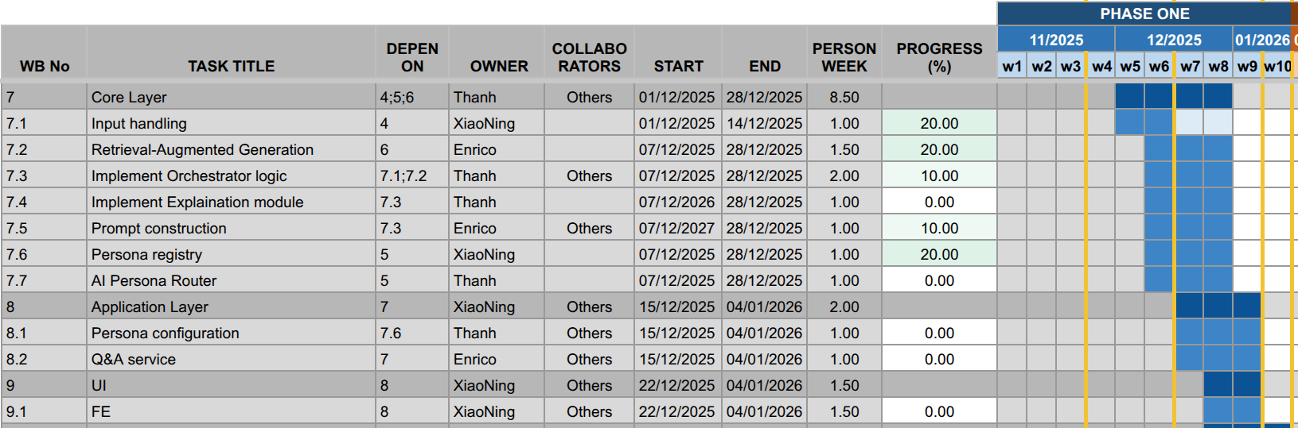
Manage - Gantt

Slide 23
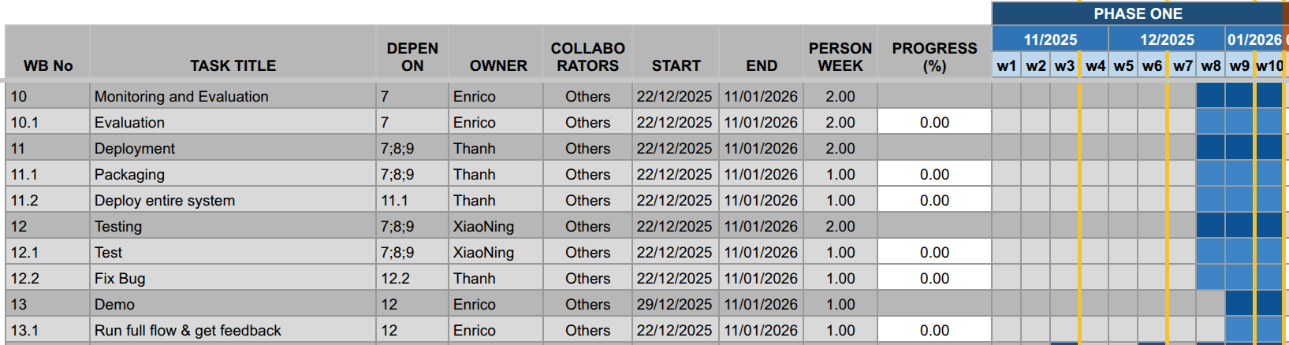
Manage - Gantt

Slide 24
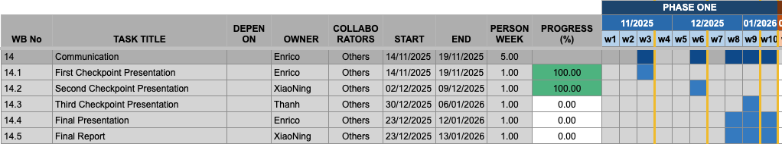
Manage - Gantt

Slide 25
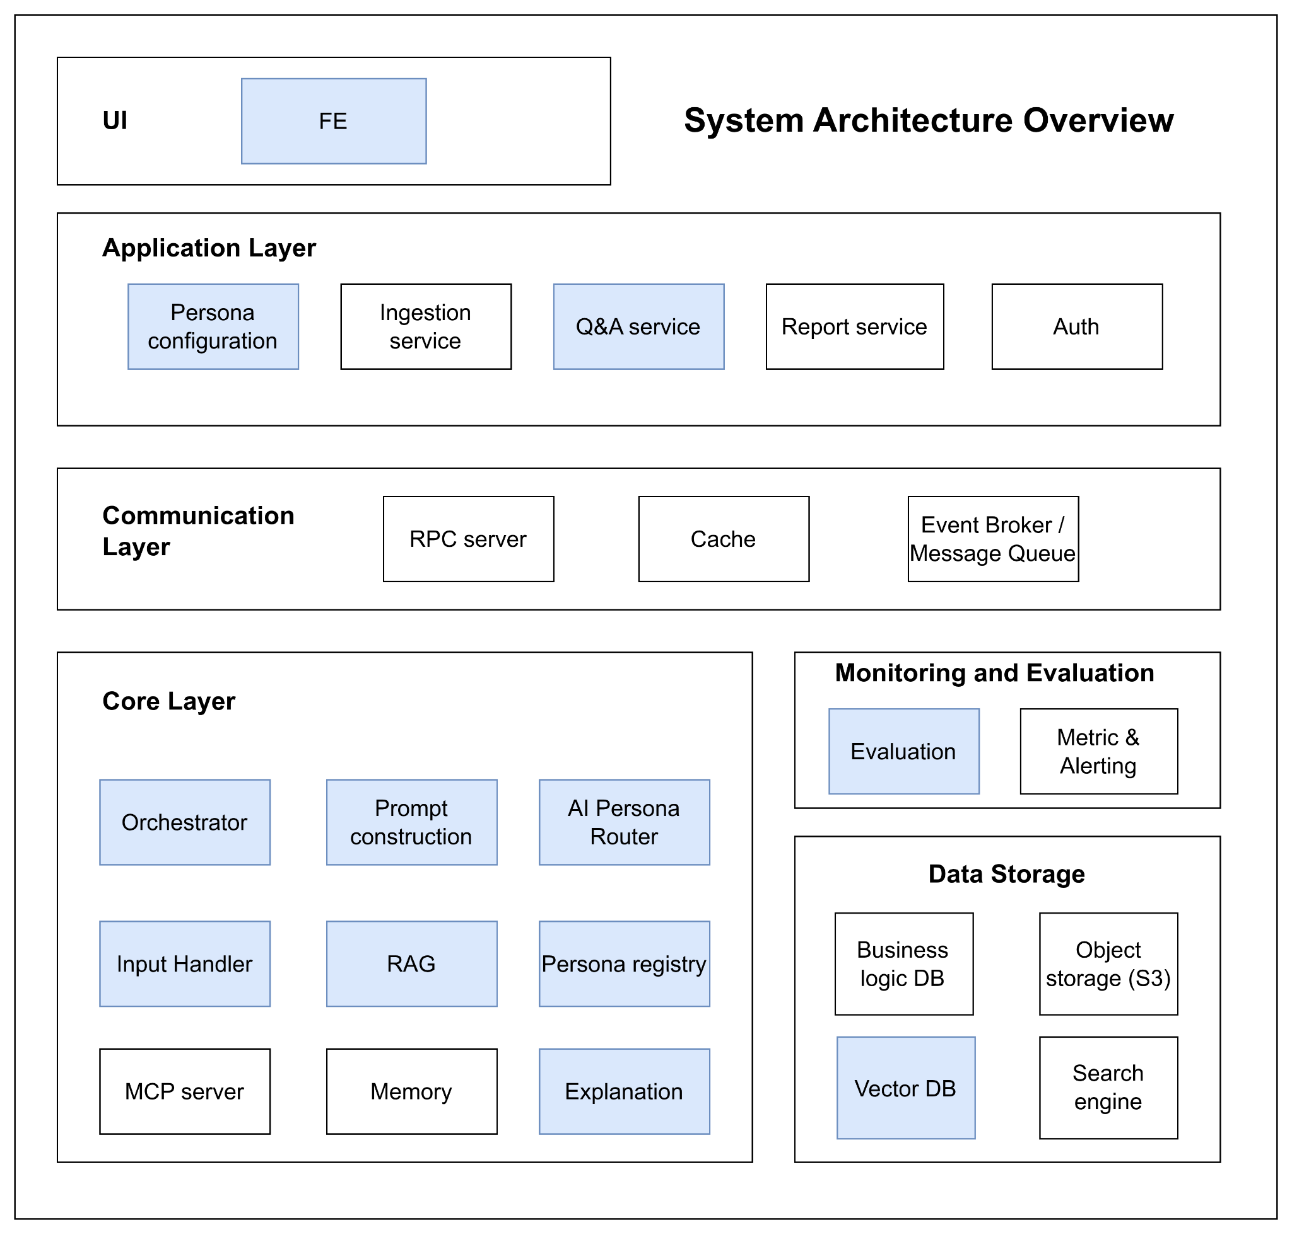
Design
1. User Interface (UI)
The user interface serves as the system’s entry point, built as a Frontend (FE) application. It enables users to interact seamlessly with the platform, submit queries, upload data, and view results or reports.
2. Application Layer
This layer contains the core application logic and manages all user-driven workflows.
Key components include:
Persona Configuration: Enables users to select or customize AI personas dynamically.
Ingestion Service: Handles ingestion of raw data such as PDFs or images and stores them in S3.
Report Service: Generates structured, formatted reports from processed and analyzed data.
Q&A Service: Manages interactive question-and-answer exchanges with the AI.
Auth Service: Provides authentication and authorization for users, ensuring secure access and operations.
3. Communication Layer
This layer facilitates efficient communication and coordination among microservices.
RPC Server: Enables direct service-to-service communication via Remote Procedure Calls.
Cache: A high-speed memory layer that stores frequently accessed data to optimize performance.
Event Broker / Message Queue (RabbitMQ or Kafka): Handles asynchronous communication and event-driven processing across services, ensuring reliability, scalability, and robust monitoring.

Slide 26
Design
4. Core Layer
The intelligence engine of the system—handles AI persona logic, LLM orchestration, and data-driven grounding.
Orchestrator: The central coordinator of the Core Layer. When a request arrives, the Orchestrator manages the entire generation process, directing which services to call.
Input Handler: Preprocesses and normalizes user inputs, including text extraction from PDFs and preparation of image data for AI analysis.
Prompt Construction: Dynamically builds structured prompts by combining user input, persona rules, and retrieved data.
AI Personas: Represents the fine-tuned Large Language Models (LLMs) tailored to embody distinct customer segment personalities.
RAG (Retrieval-Augmented Generation): Provides factual grounding by retrieving relevant information from the Vector DB, ensuring responses remain accurate.
Persona Registry: Stores the static attributes and behavioral definitions of each persona, guiding prompt construction and response tone.
Explanation: This module allows for an in-depth explanation of the thought process behind the reasoning model and the data used in the thinking process.
MCP Server (Model Context Protocol Server): Enriches LLM interactions with real-time contextual or external domain data.
Memory: It stores the recent history of the user's chat, allowing the persona to remember what was said earlier in the conversation and provide context-aware answers.

Slide 27
Design
5. Monitoring and Evaluation
A centralized observability layer that tracks performance, quality, and reliability across all services.
Evaluation Tools: Measure the accuracy and quality of AI responses and data processing outcomes.
Metrics & Alerting: Monitor key indicators such as latency, error rates, resource utilization, and token usage, triggering alerts for anomalies or system degradation.
6. Data Storage Layer
The persistence foundation of the system, designed for scalability, durability, and speed.
Business Logic Database: Stores structured data such as user profiles, authentication records, saved reports, and persona definitions.
Object Storage (S3): Manages large, unstructured data files (e.g., raw PDFs, images, and uploaded datasets).
Vector Database: Stores embeddings for persona-related documents, historical interactions, and reference materials — powering RAG retrieval and factual grounding.

Slide 28
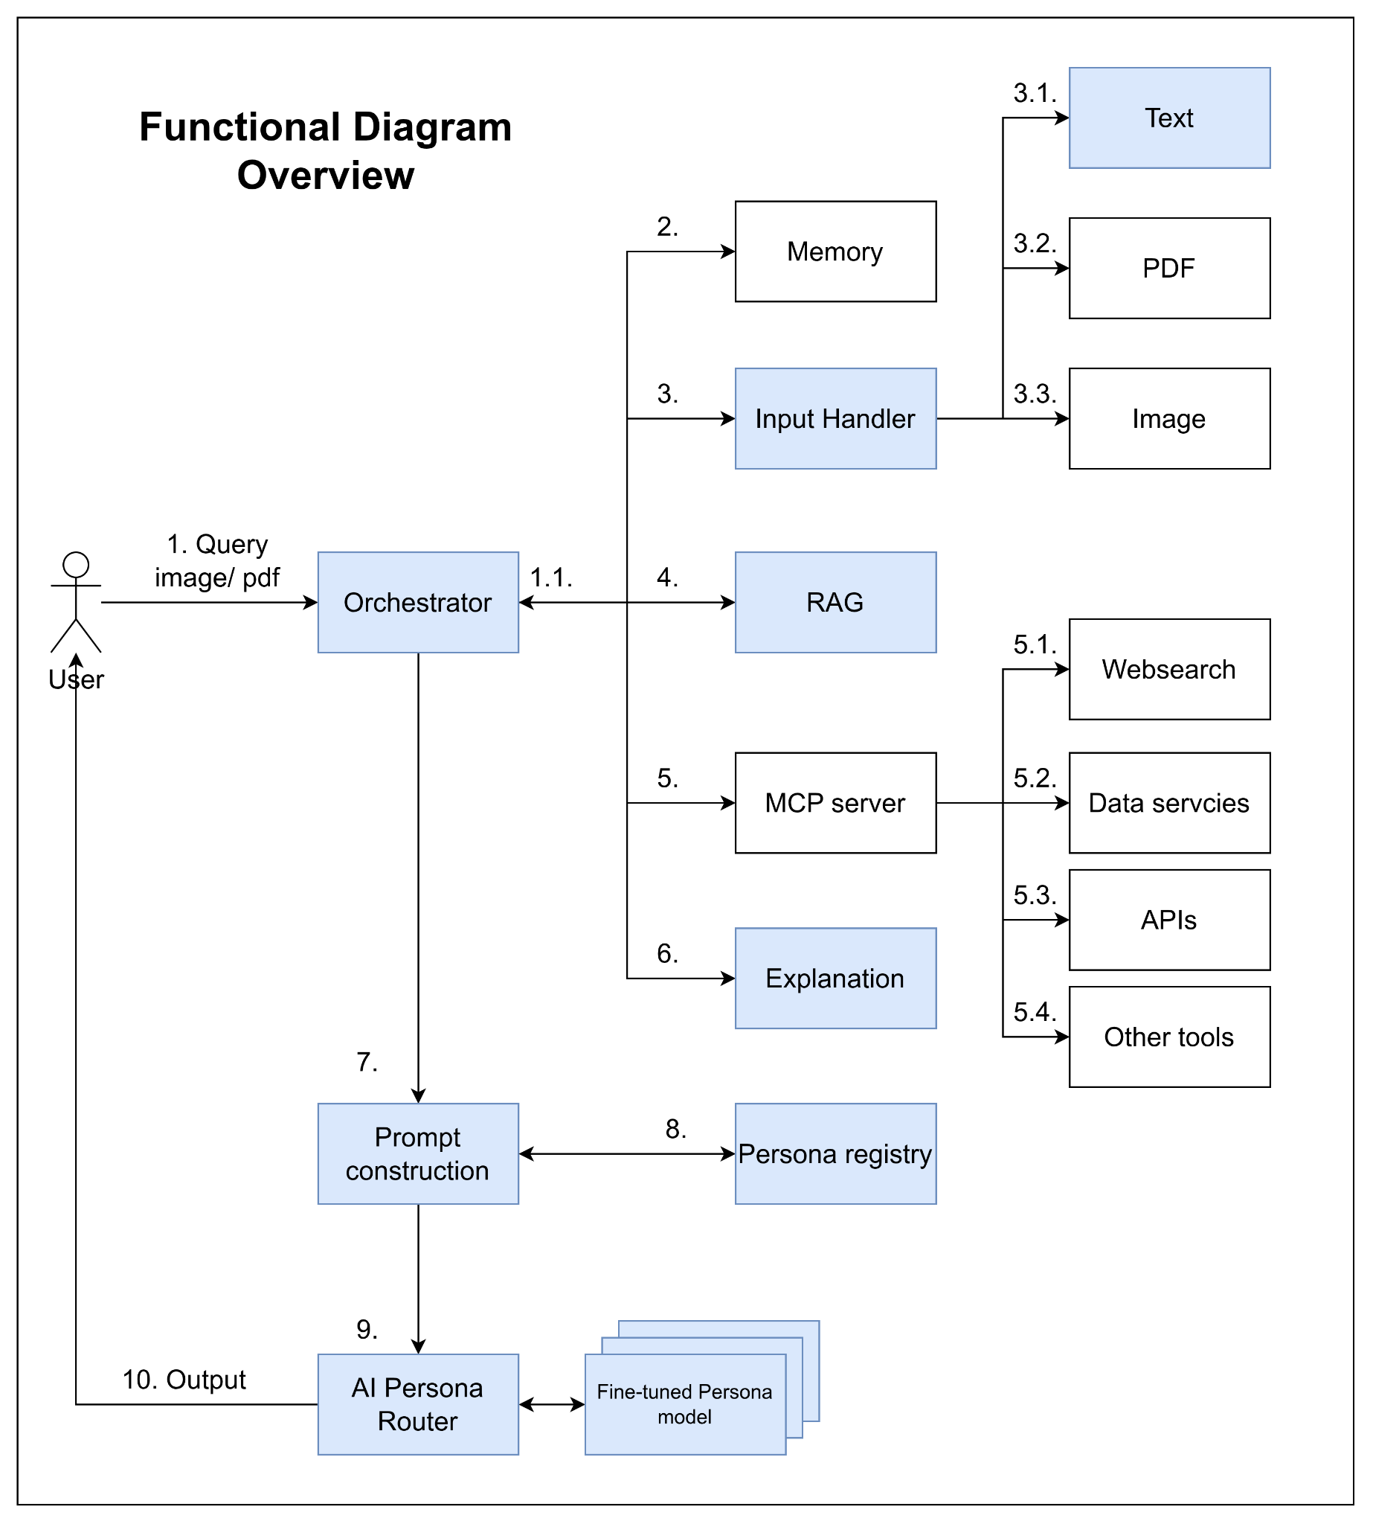
Design
1. User Query Submission: User sends a query with optional attached files (image, PDF, etc.) to the Orchestrator.
1.1 Orchestrator Analysis: The Orchestrator analyzes the query and attachments to decide which services should be used.
2. Memory Integration :Extract useful information from chat history.
3. Input Preprocessing: Inputs are preprocessed before passing to the model.
3.1 Text Input: Normalize text to make it easier to handle in later steps.
3.2 PDF Input: Parse, process, and extract meaningful information from PDF files.
3.3 Image Input: Process images and extract valuable information.
4. Context Retrieval (RAG System): Use the query and relevant input information to retrieve context (e.g., market data) via a RAG system.
5. Tool Selection & MCP Server Requests
Decide which tools should be used to enrich the context.
Send requests to the MCP server to gather corresponding context.
5.1 Web Search: Extract updated information from the internet (trends, real-time data, missing internal data, etc.).
5.2 Database Query: Retrieve useful data from internal or external databases.
5.3 External APIs: Call APIs to obtain additional information.
5.4 Other Tools: Use calculators, simulators, weather data extractors, or other utilities to enrich context.
6. Explanation: The explanation module will explain in detail the thought process of the reasoning model and the data used for the thinking process.
7. Prompt Construction: The Orchestrator aggregates useful context and passes it to Prompt Construction.
8. Persona Selection :Apply the selected Persona profile, including: Demographics, Behavior Data, Transactional Data, …
9. Persona Model Routing
Route to a fine-tuned Persona model.
Pass the enriched prompt and context.
10. Model Response: Generate a response with: Specific personality,Tone, Linguistic style of the Persona

Slide 29
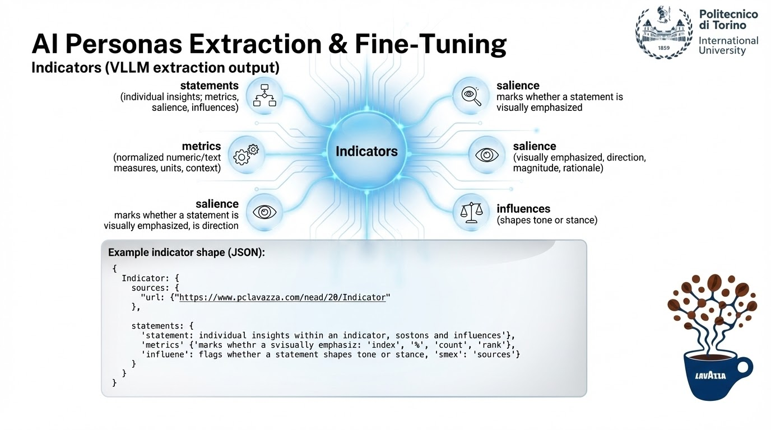

Slide 30
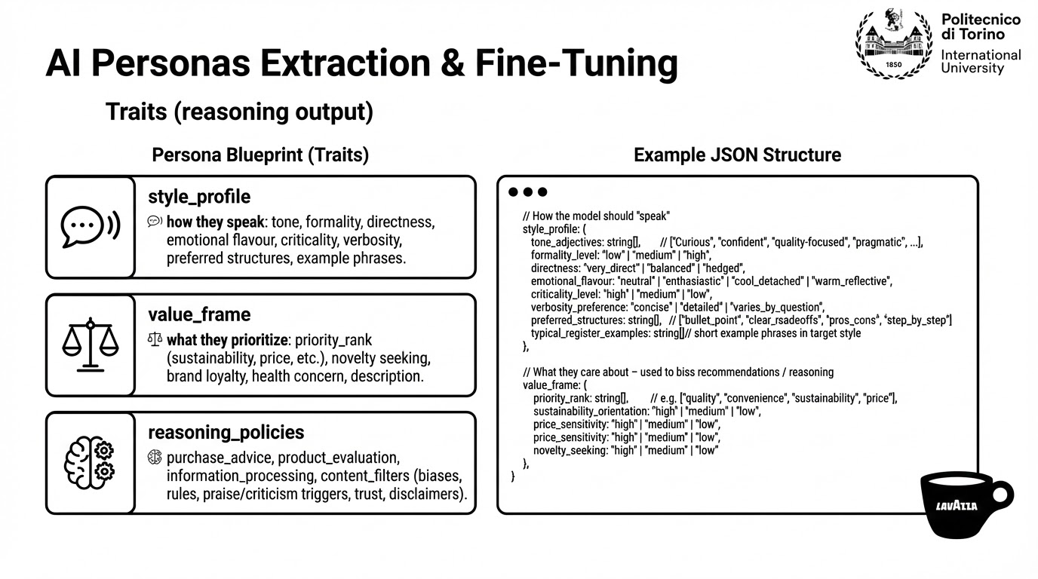

Slide 31
Design - Risks Analysis
Technical Risks
Hallucinations and inaccurate responses: mitigate with RAG system
Insufficient critical thinking: mitigate with RAG and prompt engineering
Opacity: mitigate with RAG
Inconsistent or generic personality: mitigate by fine-tuning (in case of limited resource use PEFT, smaller models, RAG with few-shot prompting)
Performance evaluation difficulty

Slide 32
Design - Risks Analysis
Governance and Security Risks
Privacy and compliance with AI Act and GDPR
Proprietary data protection
System integration difficulty with existing systems and infrastructure
Notes:
Privacy and Complience: complice AI acts and GDPR.
Proprietary Data Protection: Safeguard Lavazza’s business data, maintaining strict confidentiality and preventing unauthorized access.
System Integration: Ensure smooth and secure alignment of AI solutions with Lavazza’s existing company systems and infrastructure.

Slide 33
Design - Risks Analysis
Data and Other Risks
Data integration difficulty
Data quality and bias
Over relying on AI Personas
Notes:
2. Data Risks
Data Integration Challenge: Heterogeneous (e.g., PDFs, tabular data, …)
Quality and Bias Issues: Data may be qualitative, incomplete, or imbalanced across segments, leading to biased persona representations and limited generalizability.

